Slide 1









CLECKFAX TRADERS HUB
FINAL PRESENTATION
THE BRITISH COLLEGE | 2025
1

Slide 2
TEAM MEMBERS
Page No
SWOSTIK NEPAL
SAMPURNA SIMKHADA
SAMPURNA GAUTAM
SUYASH RIJAL
ROSHAN KUMAR ADHIKARI
SUPRIYA DHAKAL
37-52
53-55
56-62
32-36
23-31
1-22
2

Slide 3
INTRODUCTION
A DIGITAL MARKETPLACE THAT GATHERS LOCAL TRADERS OFFERING FRESH AND INEXPENSIVE ITEMS FOR BUYERS ONLINE WHERE USERS CAN EASILY SEARCH FOR PRODUCTS, ADD THEM TO THEIR CART, PAY SAFELY AND READ PRODUCT REVIEWS.WHAT MATTERS MOST ABOUT THIS PROJECT IS THAT IT BOTH ASSISTS USERS IN THEIR BUYING AND SUPPORTS GROWTH FOR LOCAL BUSINESSES.
3

Slide 4
INITIATION PHASE
4

Slide 5
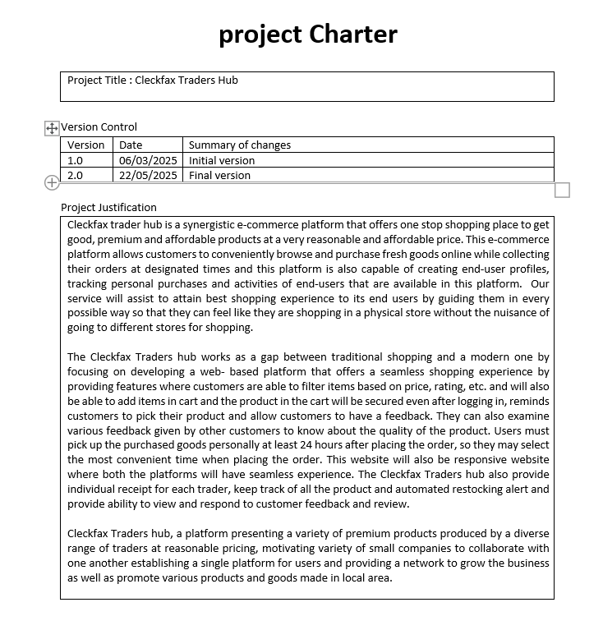
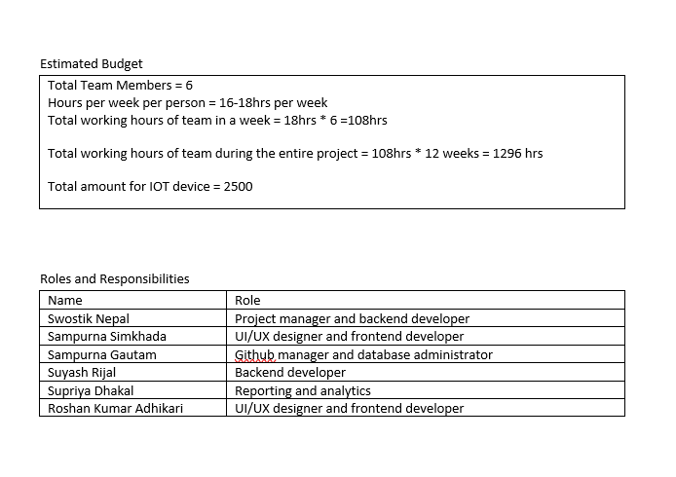
PROJECT CHARTER
5

Slide 6
PLANNING PHASE
6

Slide 7
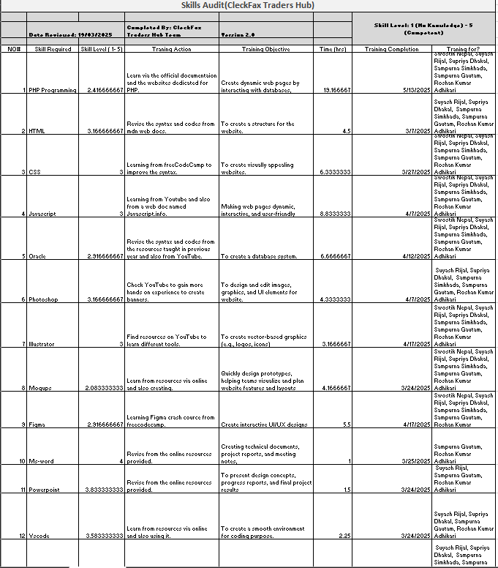
SKILL AUDIT
7

Slide 8
MS PROJECT
Ms-Project is a Microsoft product made for project management and highly praised for making project planning and management smooth.We made use of MS Project features like the Gantt Chart, Task Sheet, Timeline, Calendar and Resource Sheet on our project. With these tools, our team has organized tasks, imagined the work schedule and made sure the project is completed by the agreed deadline.
8

Slide 9
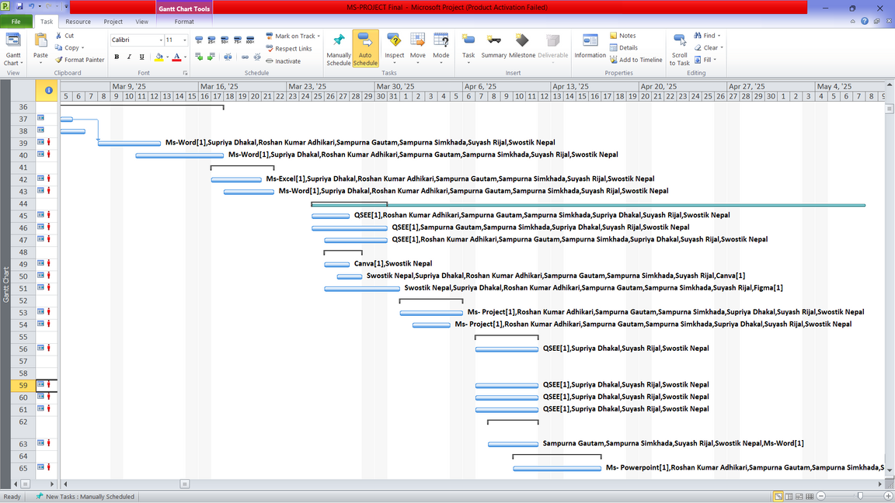
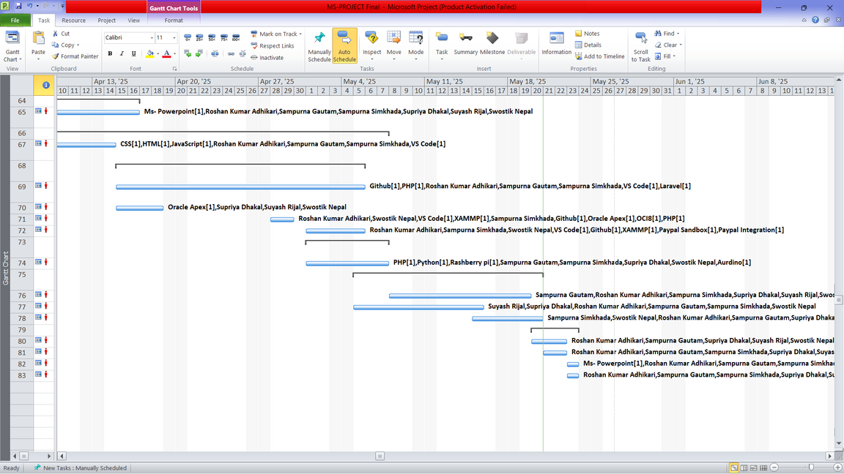
GANTT CHART
9

Slide 10
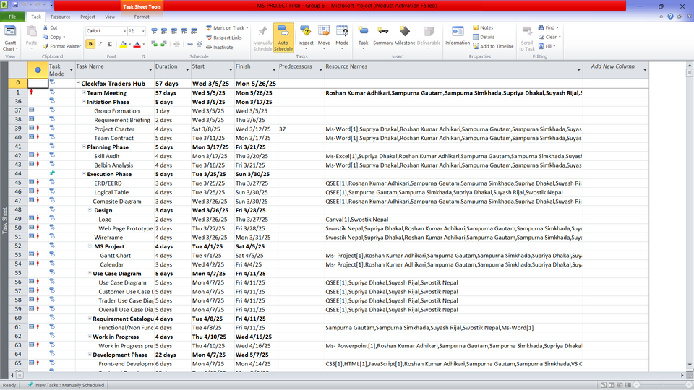
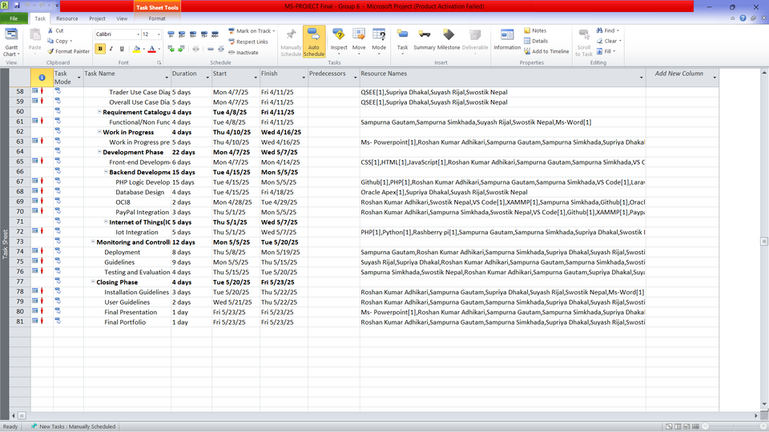
TASK SHEET
10

Slide 11
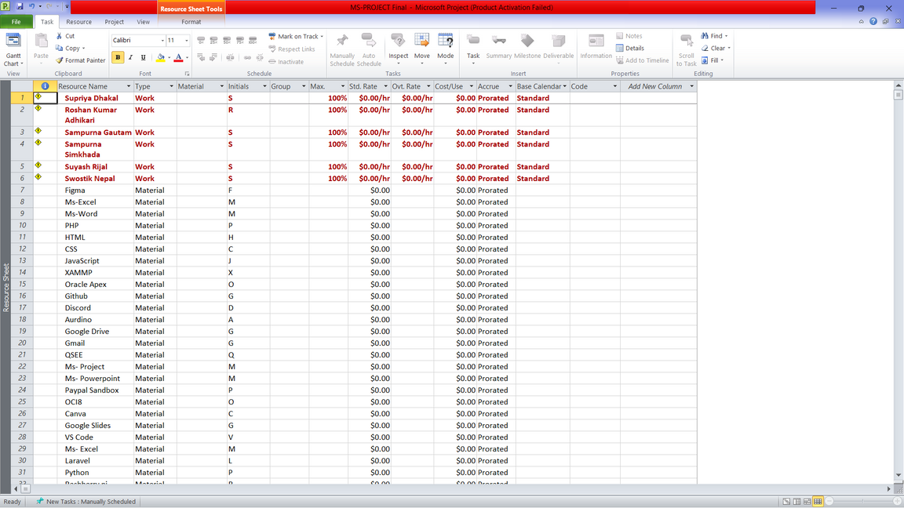
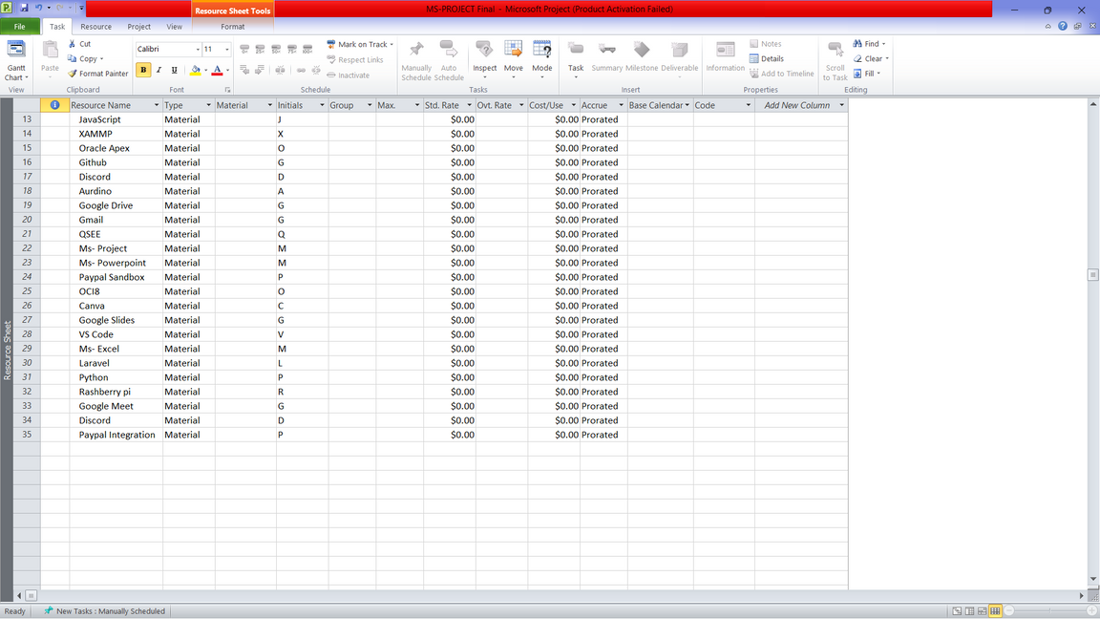
RESOURCE SHEET
11

Slide 12
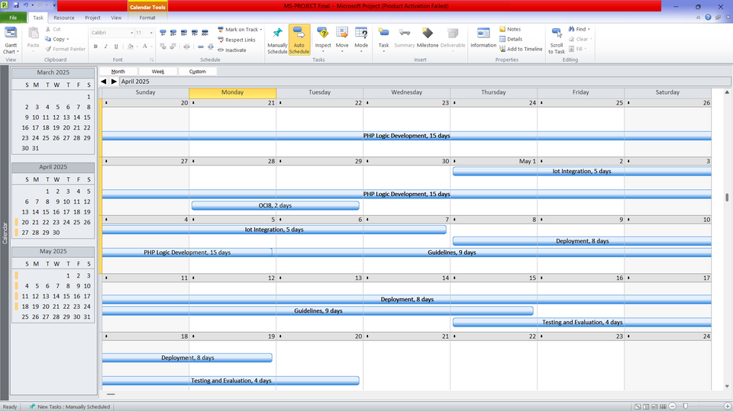
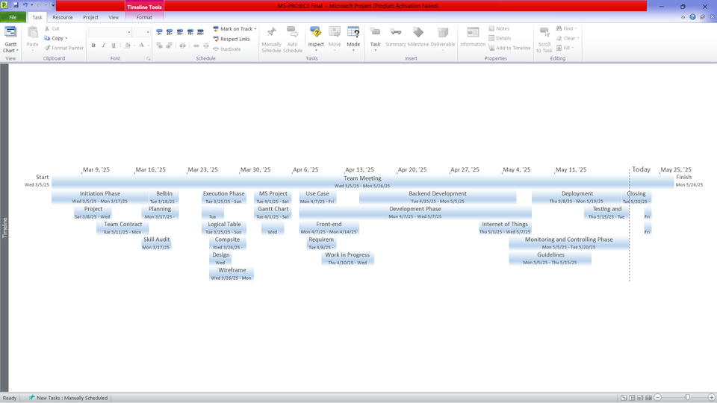
CALENDER
TIMELINE
12

Slide 13
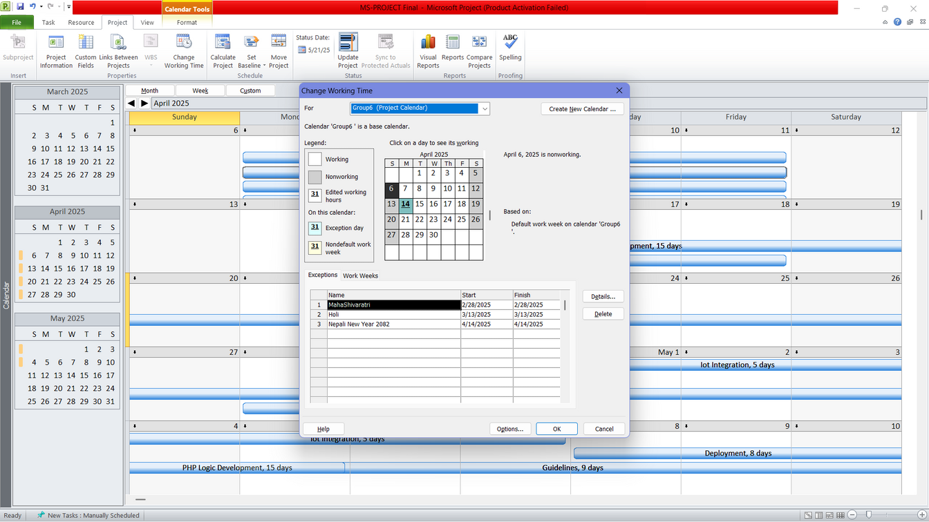
WORKING TIME
13

Slide 14
EXECUTION PHASE
14

Slide 15
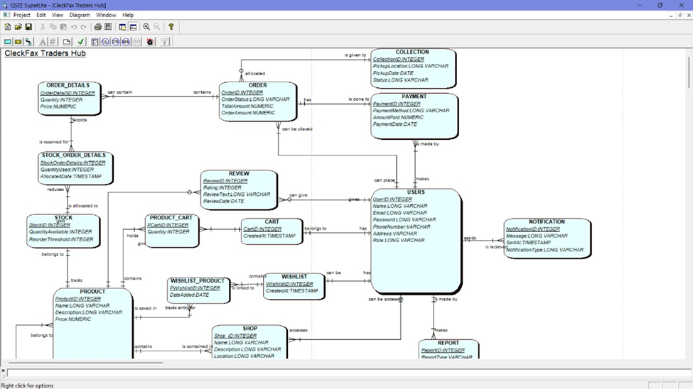
ERD(ENTITY RELATIONSHIP DIAGRAM)
15

Slide 16
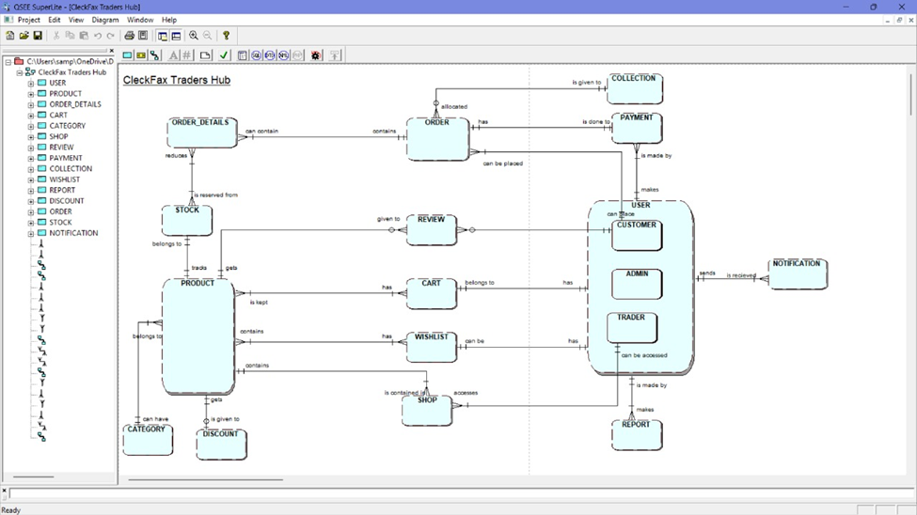
EXTENDED ENTITY RELATIONSHIP DIAGRAM(EERD)
16

Slide 17
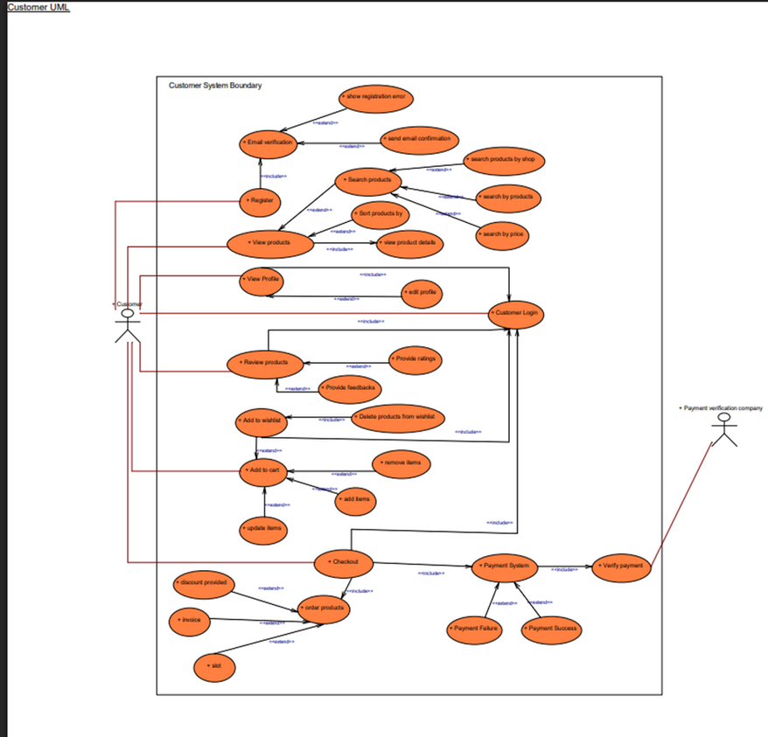
USECASE DIAGRAM(CUSTOMER)
17

Slide 18
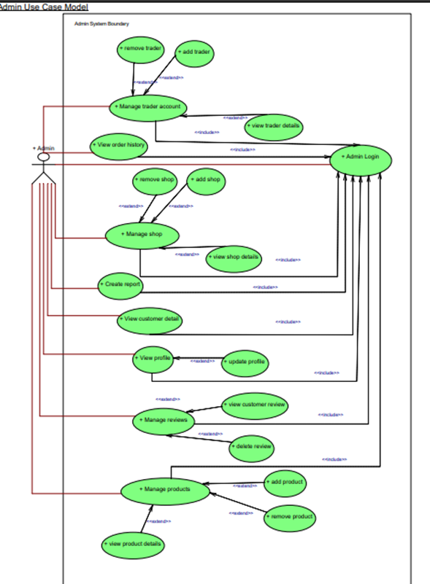
USECASE DIAGRAM(ADMIN)
18

Slide 19
RECTIFICATION AFTER WIP
19

Slide 20
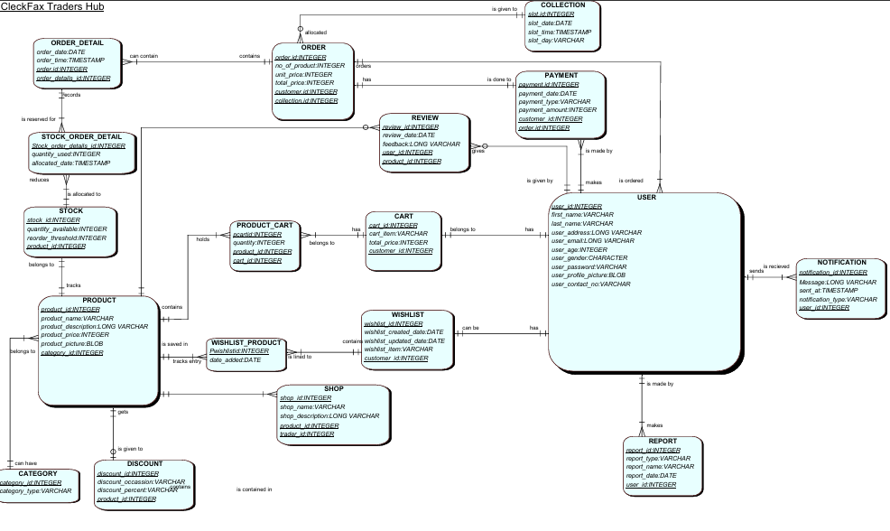
FINAL COMPOSITE
20

Slide 21
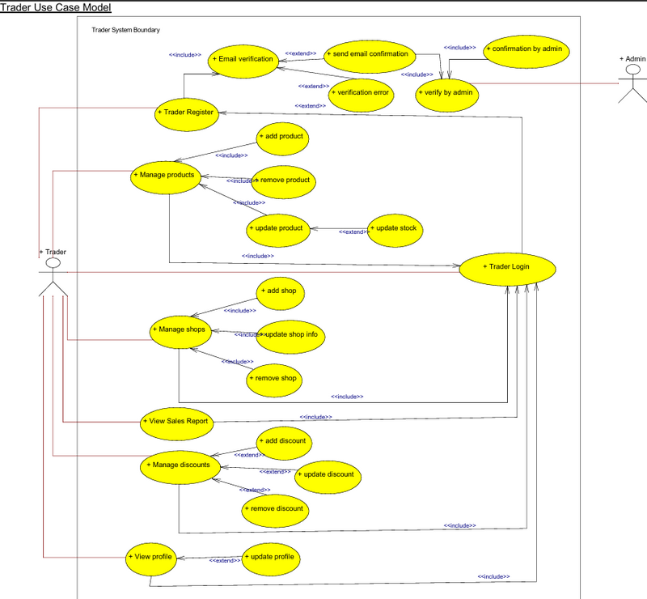
USE CASE DIAGRAM(TRADER)
21

Slide 22
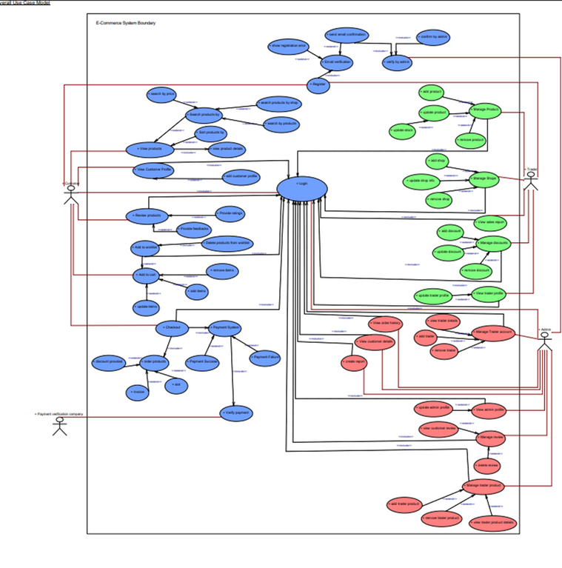
USECASE DIAGRAM(OVERALL)
22

Slide 23
PRODUCT DEVELOPMENT
23

Slide 24
CUSTOMER INTERFACE
24

Slide 25
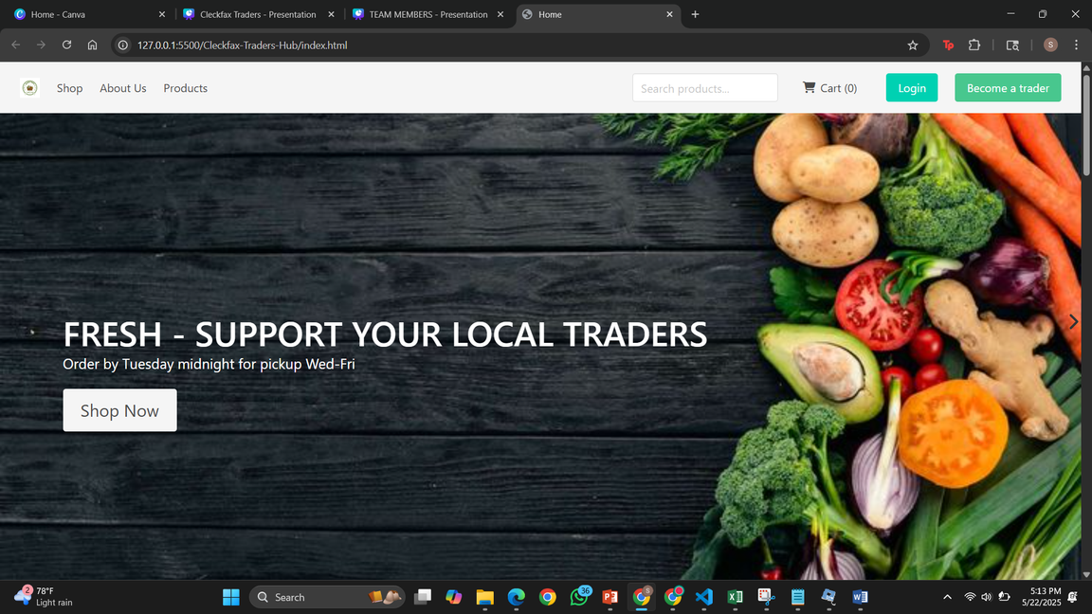
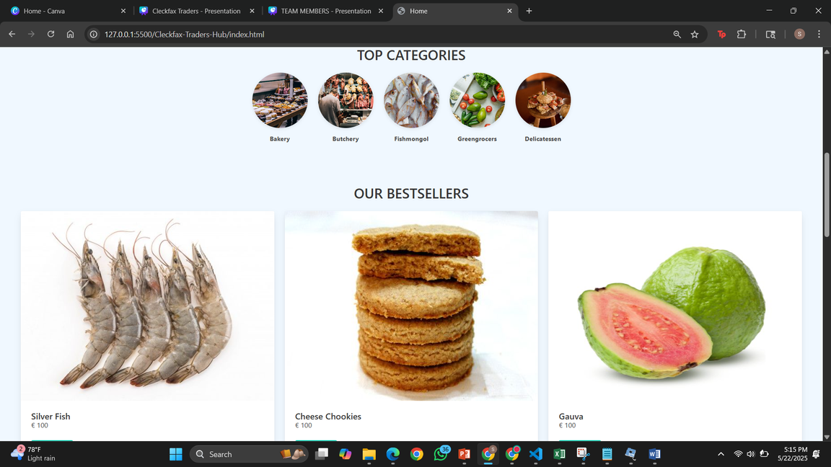
CUSTOMER VIEW
25

Slide 26
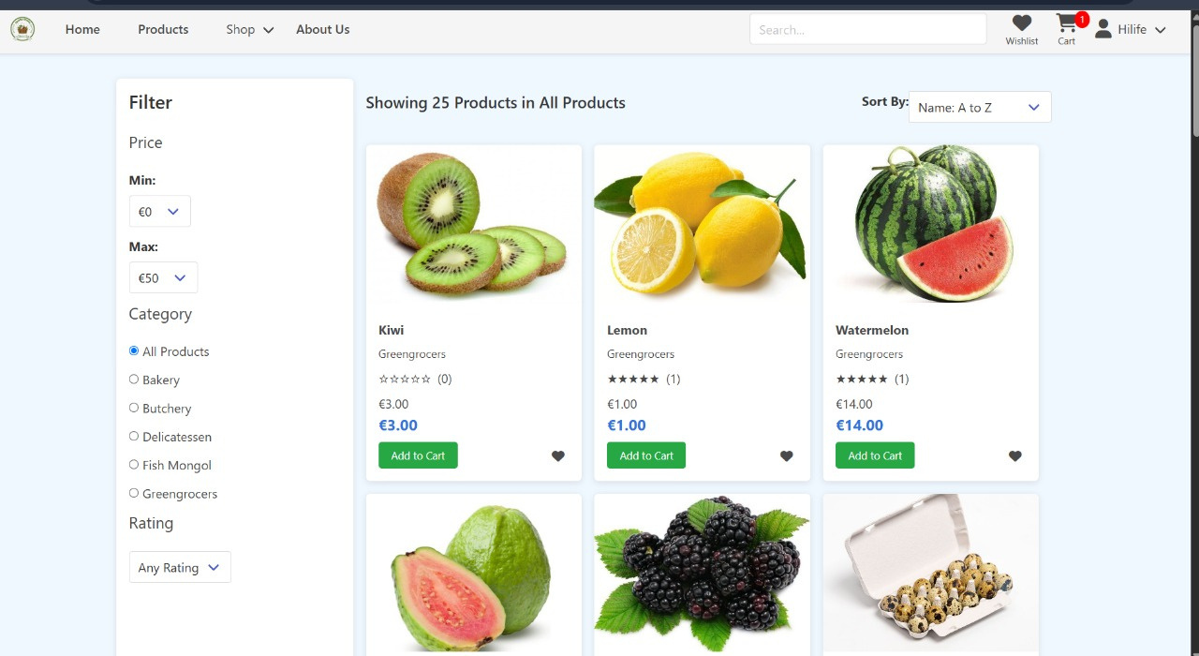
PRODUCT LISTING
26

Slide 27
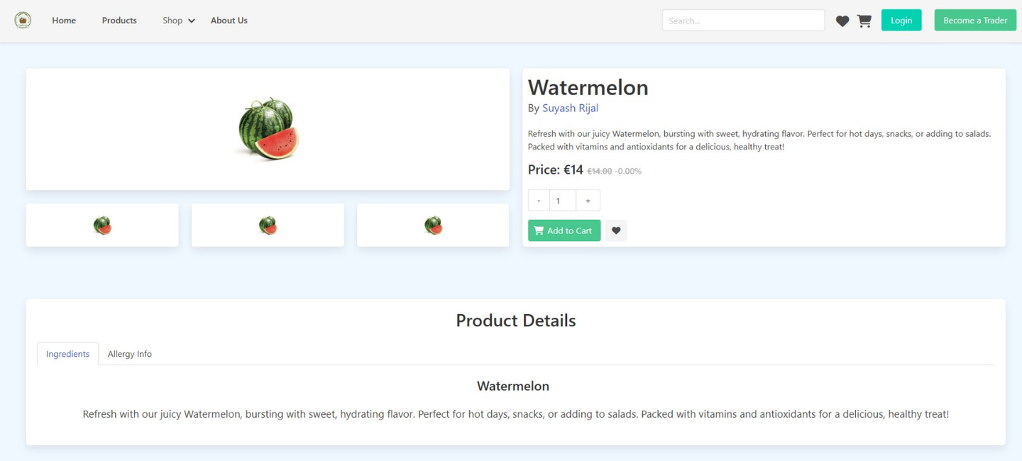
PRODUCT DETAIL
27

Slide 28
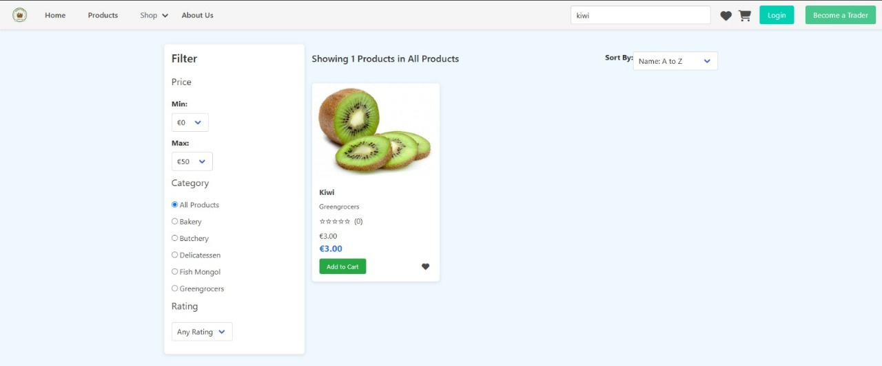
SEARCH BAR
28

Slide 29
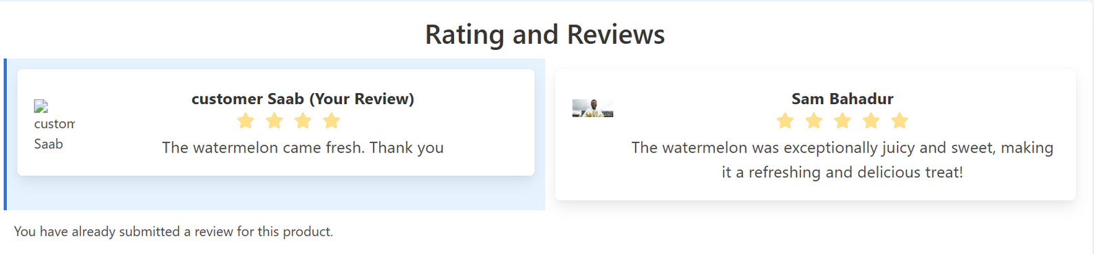
REVIEWS AND RATING
29

Slide 30
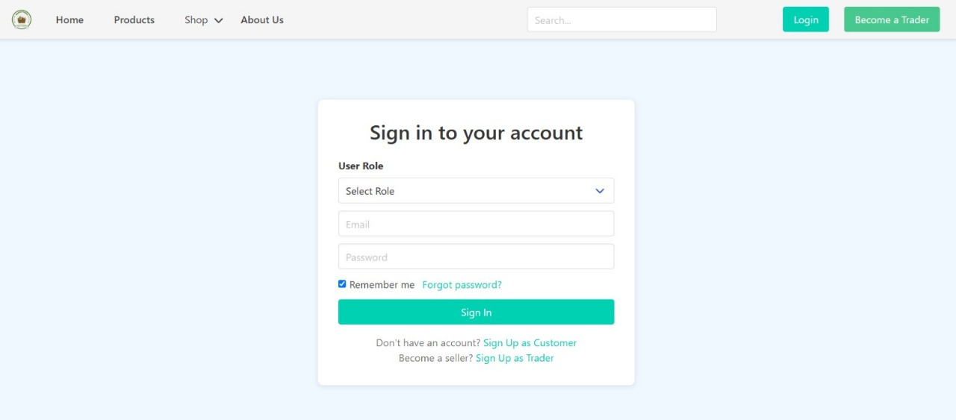
LOGIN
30

Slide 31
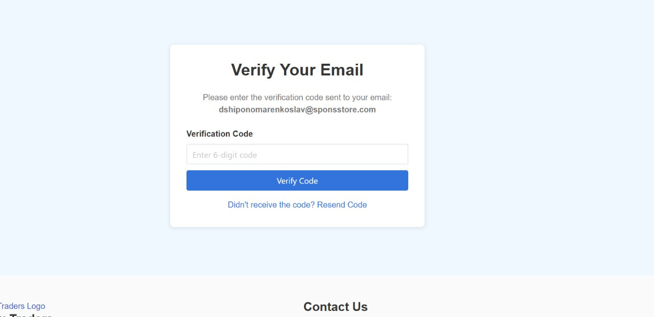
EMAIL VERIFICATION
31

Slide 32
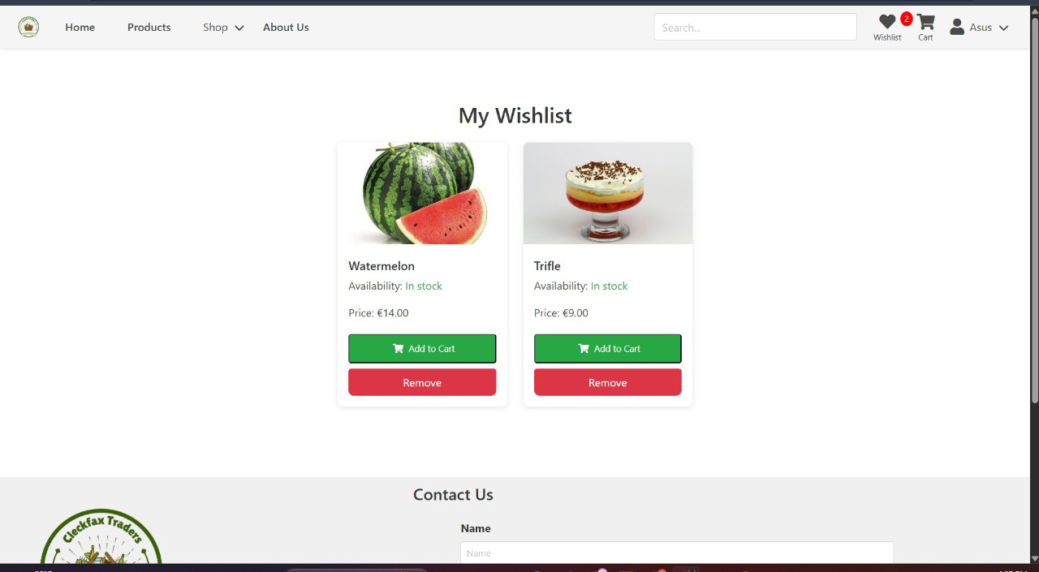
WISHLIST
32

Slide 33
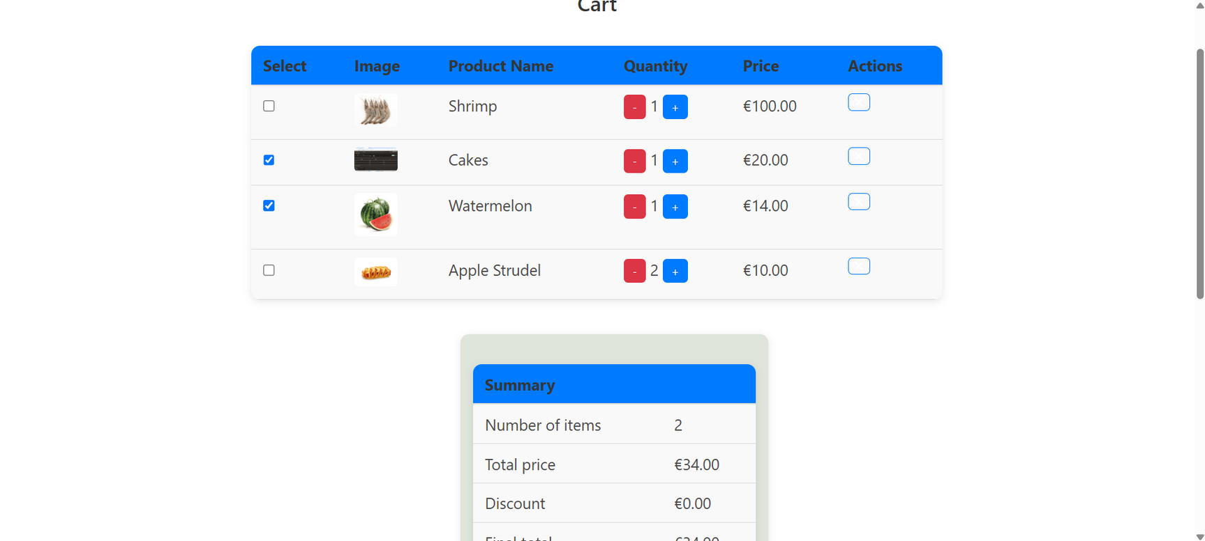
CART
33

Slide 34
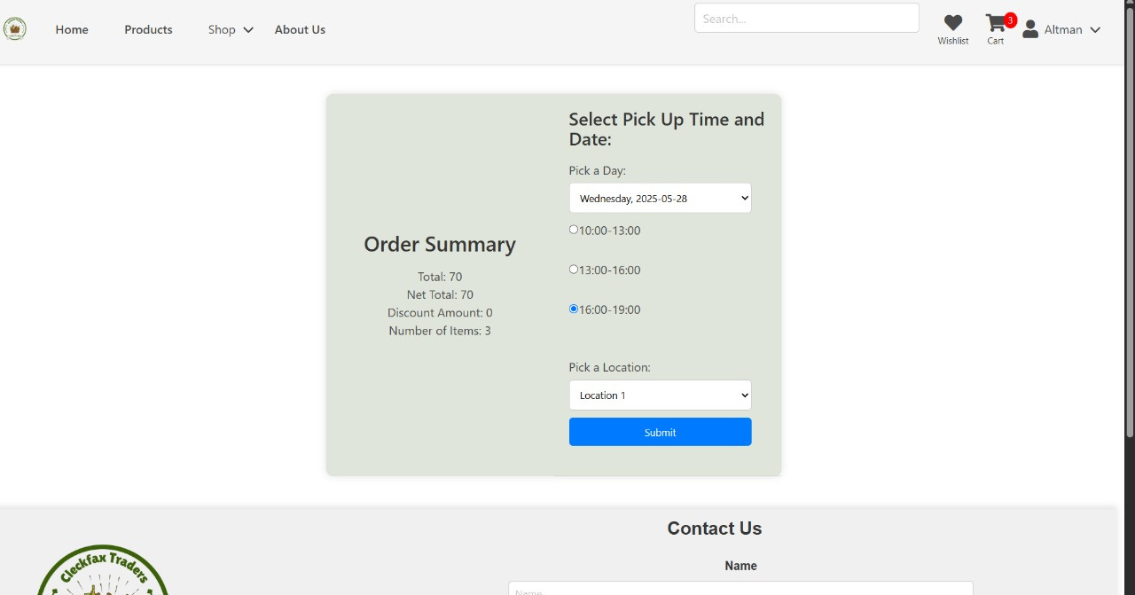
SLOTS
34

Slide 35
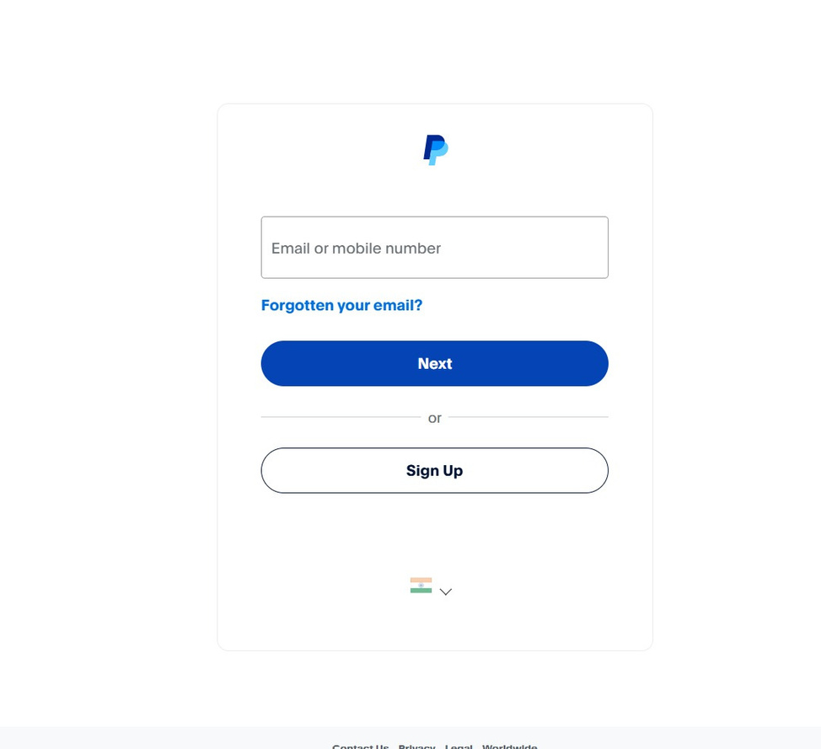
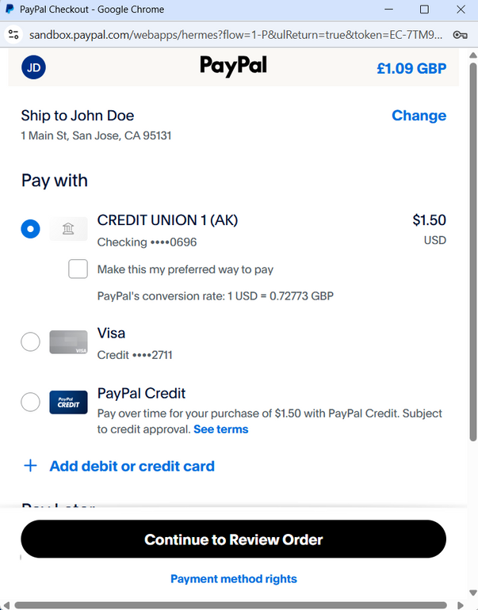
PAYMENT INTEGRATION
35

Slide 36
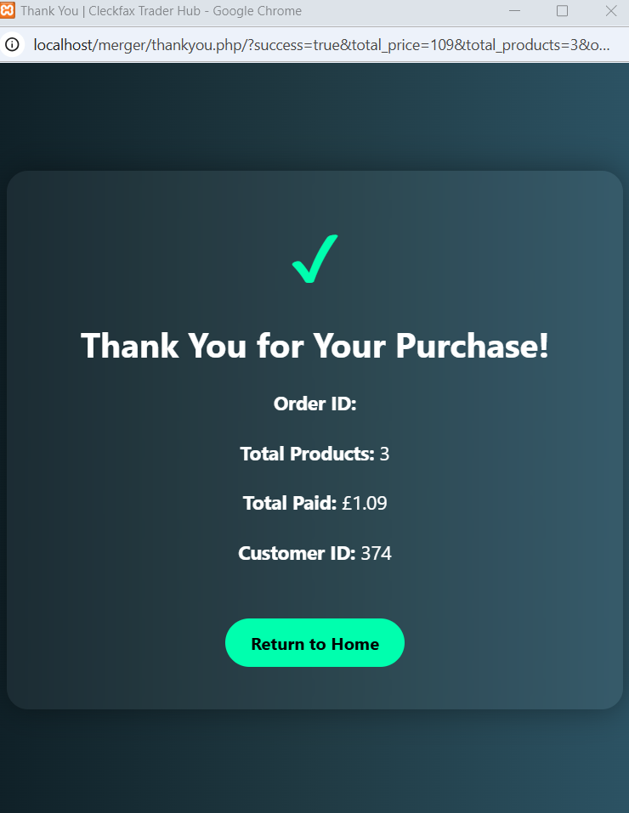
SUCCESS PAGE
36

Slide 37
TRADER INTERFACE
37

Slide 38
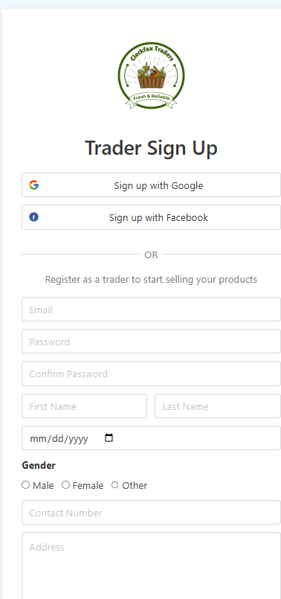
TRADER LOGIN AND SIGN UP
38

Slide 39
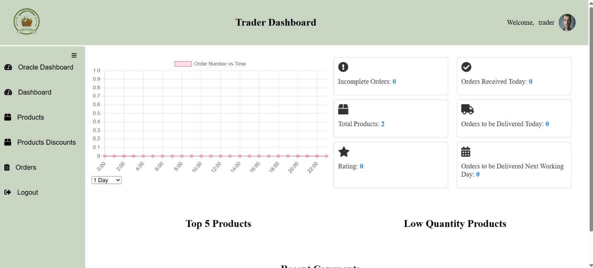
TRADER DASHBOARD PHP
39

Slide 40
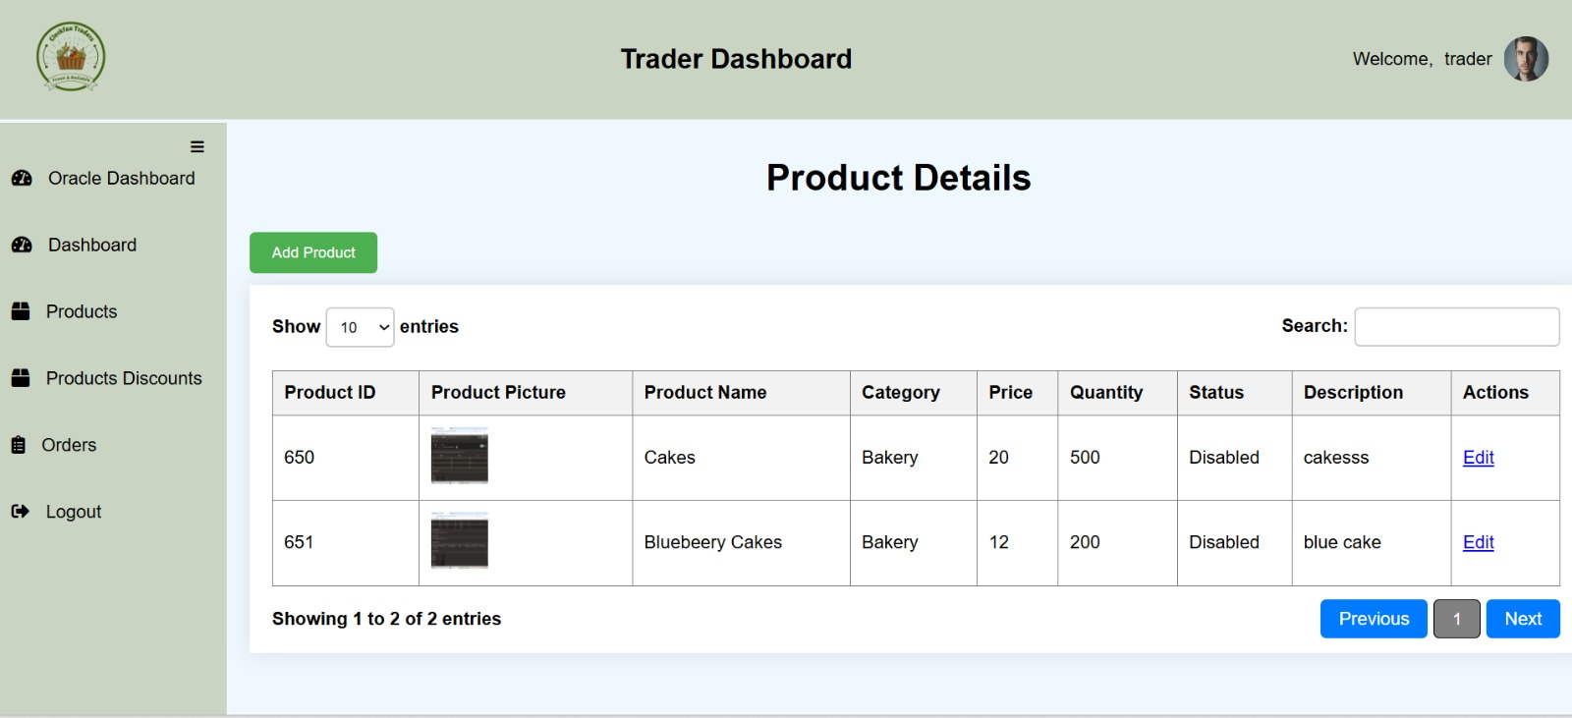
PRODUCT DETAIL
40

Slide 41
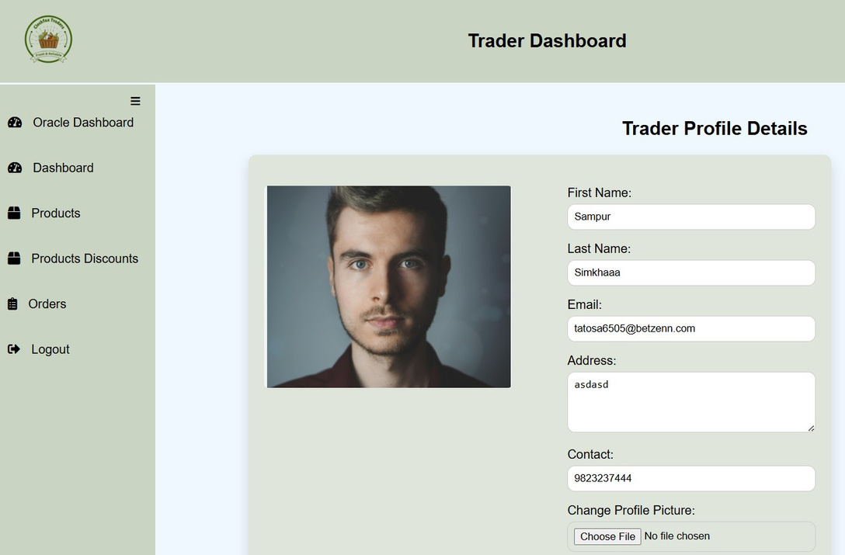
PROFILE CHANGE
41

Slide 42
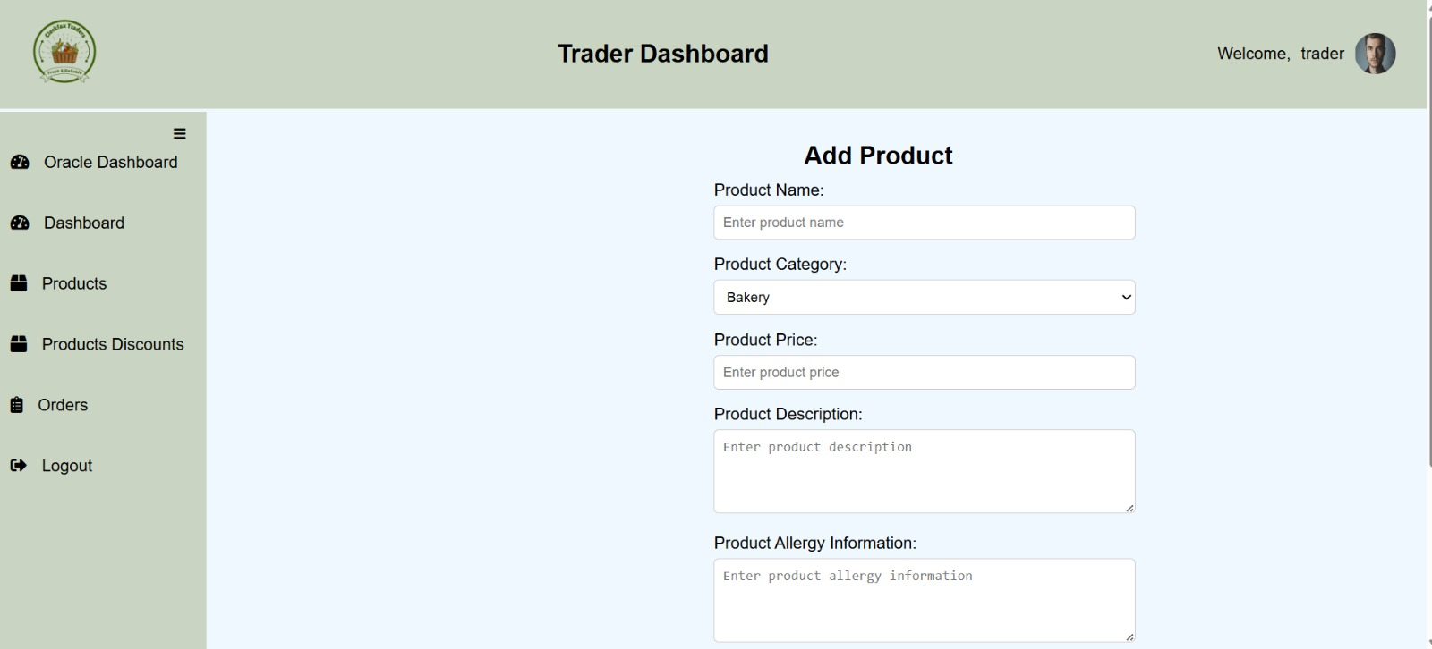
ADD PRODUCT
42

Slide 43
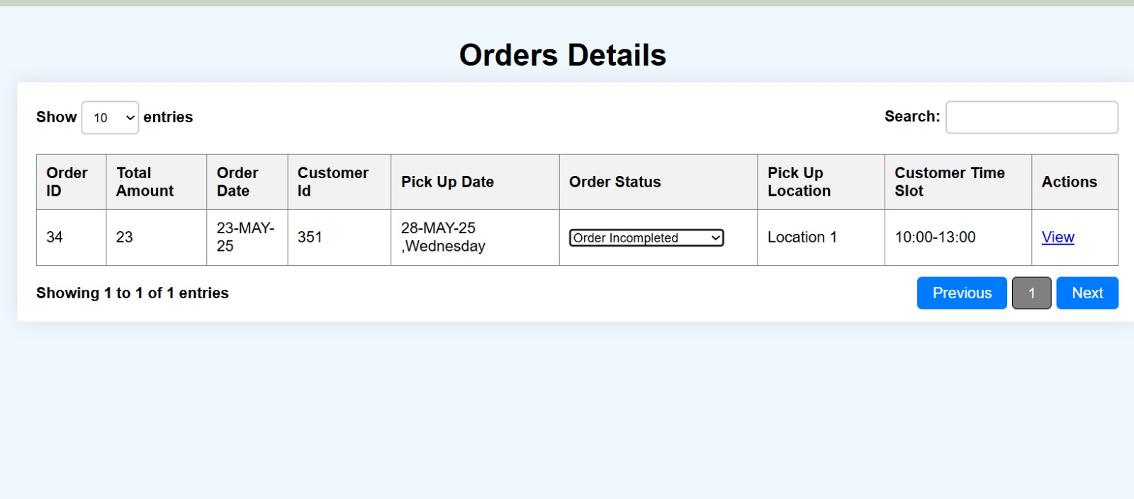
ORDER DETAILS
43

Slide 44
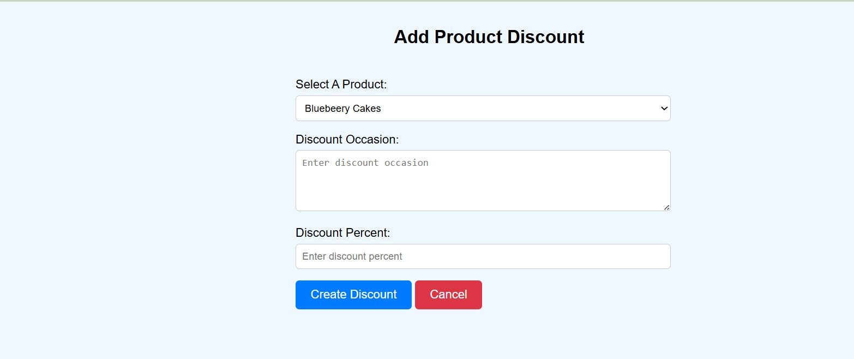
ADD PRODUCT DISCOUNT
44

Slide 45
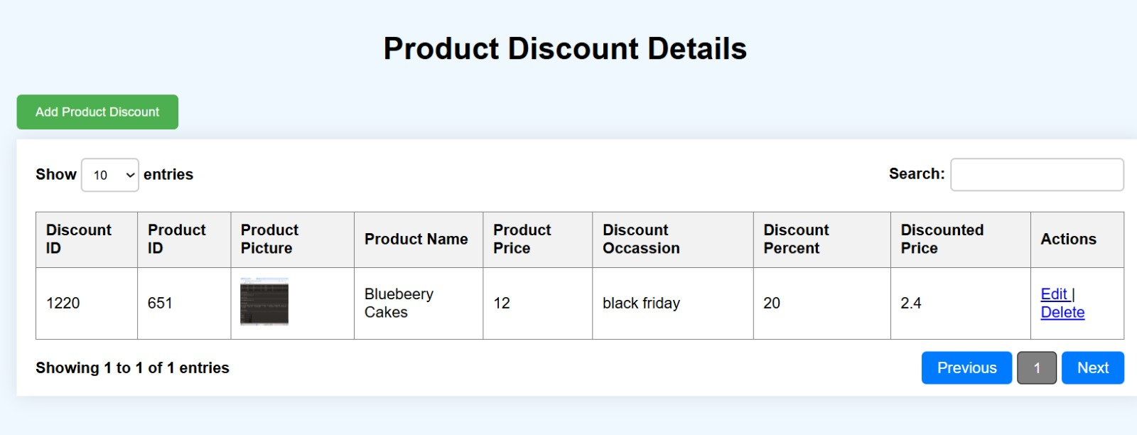
PRODUCT DISCOUNT DETAILS
45

Slide 46
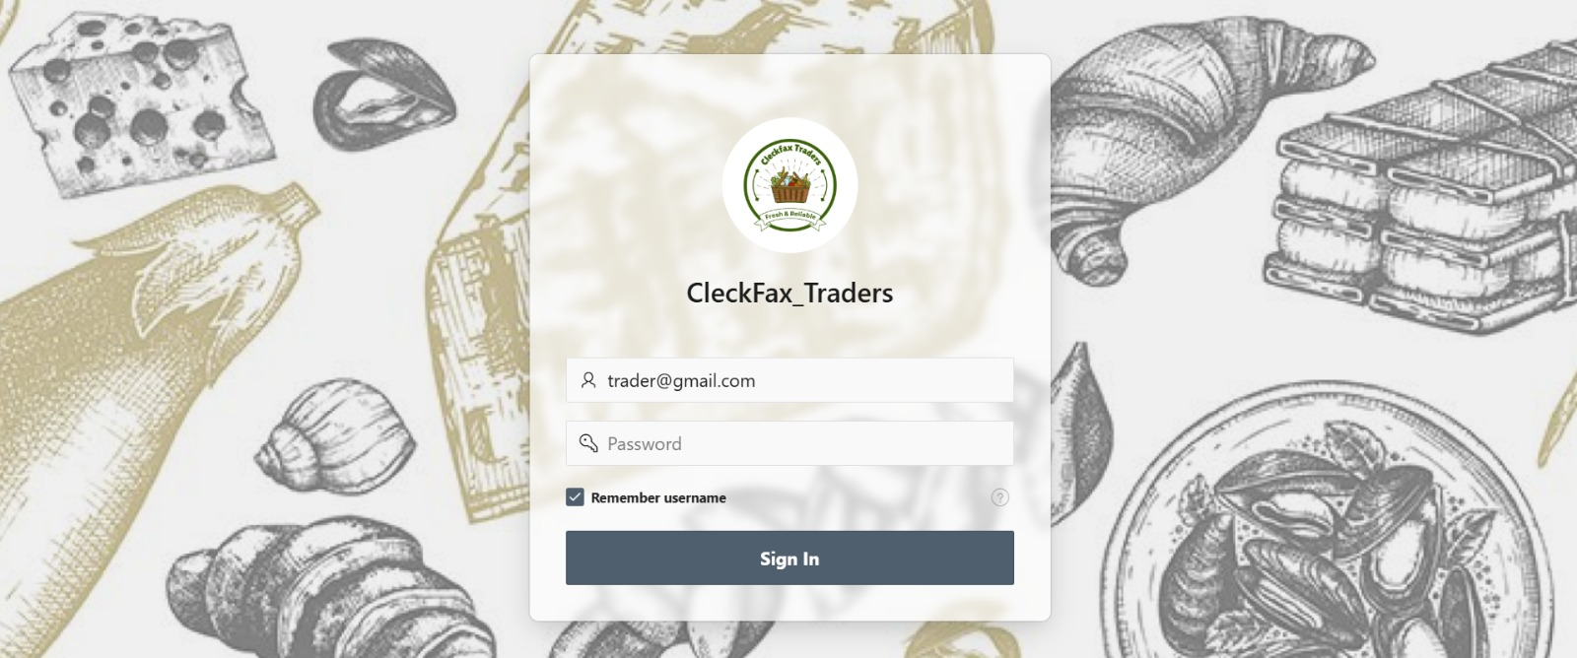
TRADER LOGIN(ORACLE)
46

Slide 47
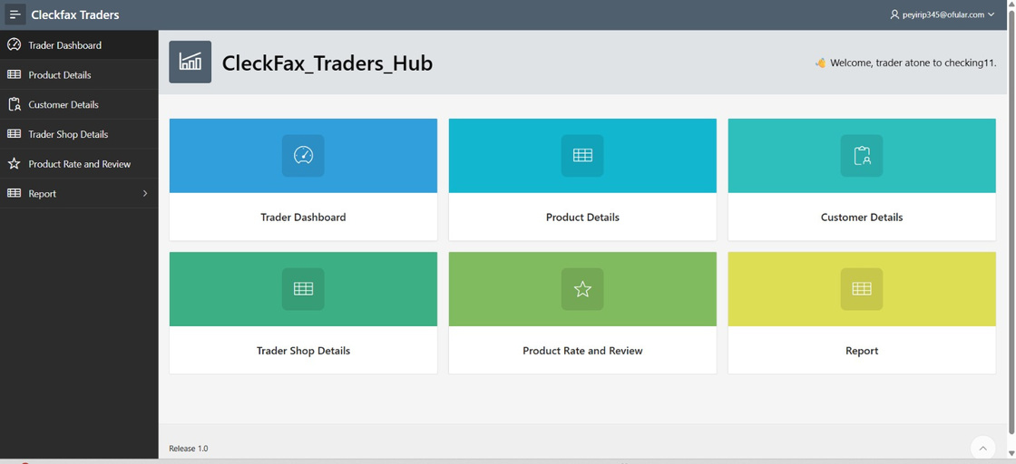
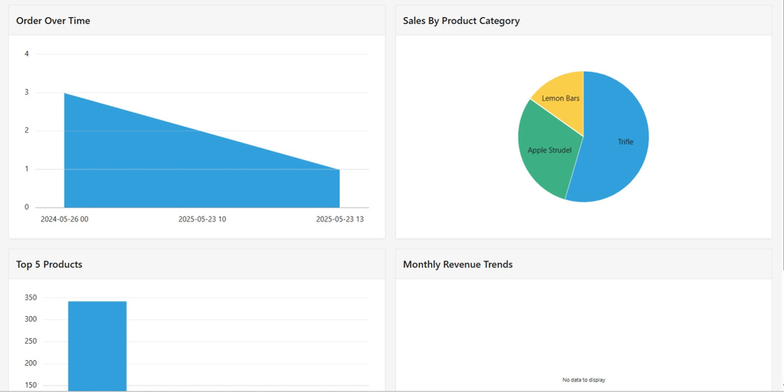
TRADER DASHBOARD
47

Slide 48
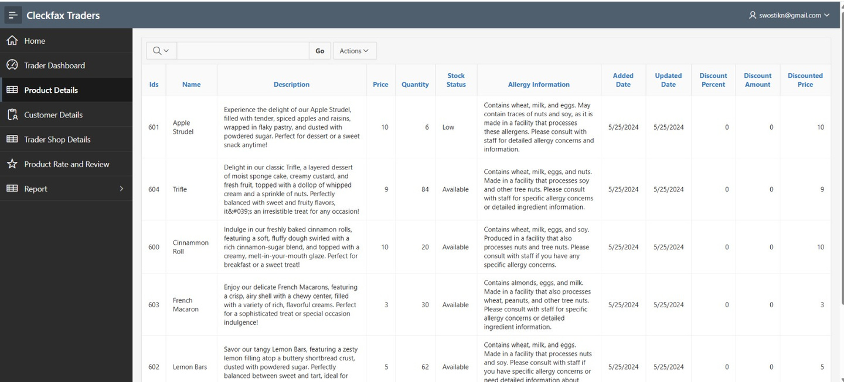
PRODUCT DETAIL
48

Slide 49
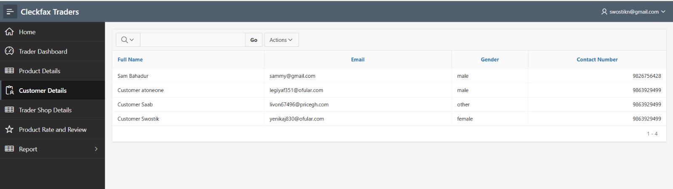
CUSTOMER DETAIL
49

Slide 50
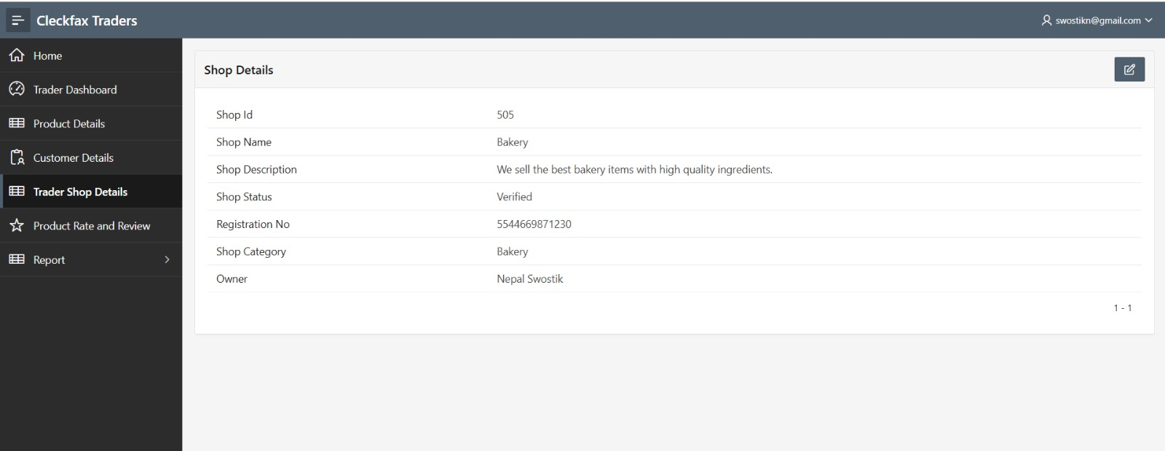
TRADER SHOP DETAILS
50

Slide 51
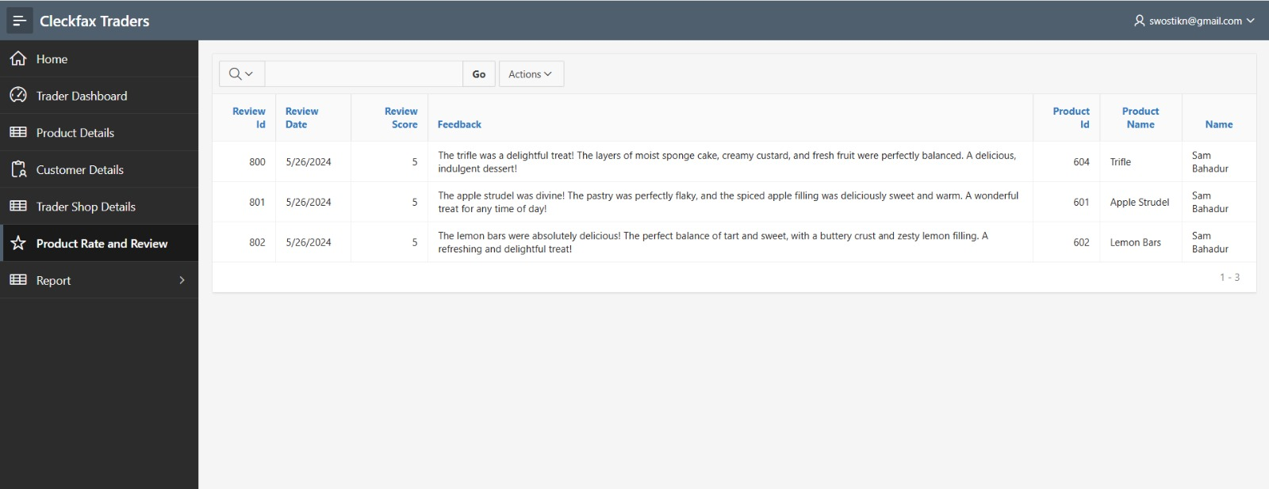
PRODUCT RATE AND REVIEW
51

Slide 52
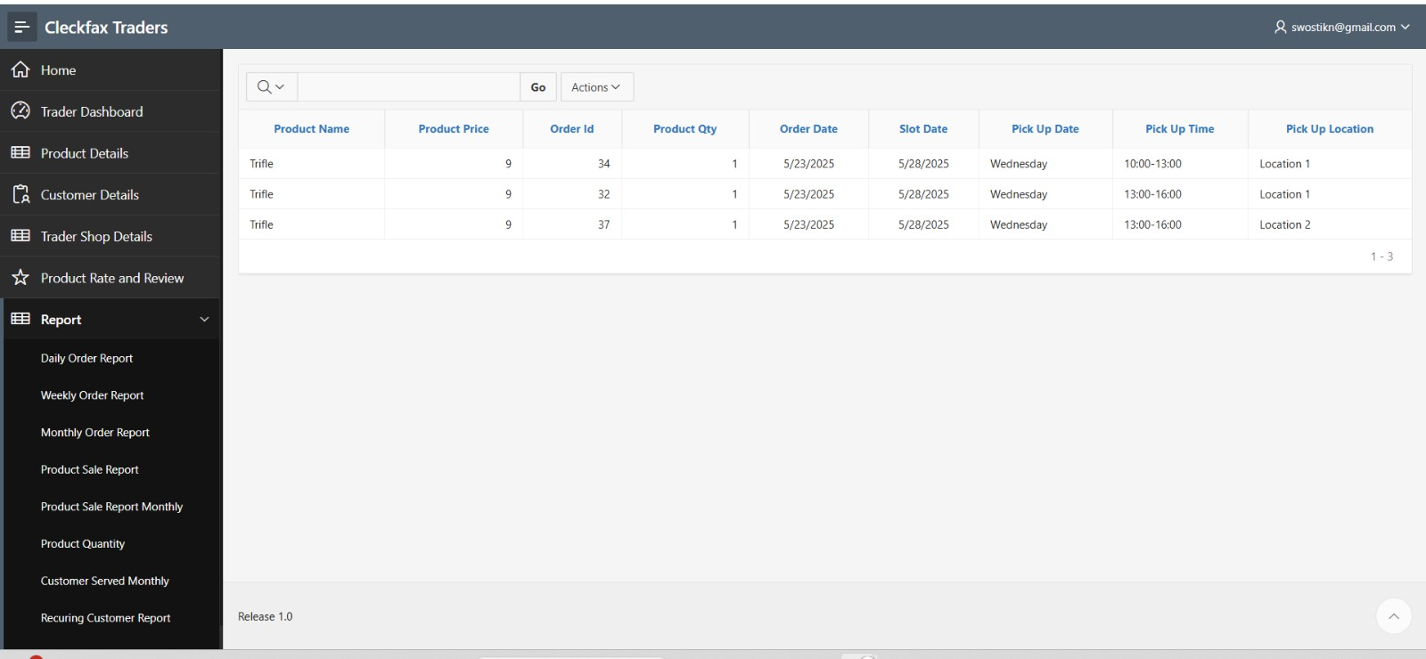
REPORT
52

Slide 53
IOT INTEGRATION
53

Slide 54
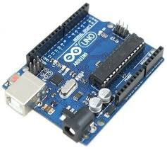

IOT INTEGRATION
DEVICES USED IN IOT
Arduino Uno R3
RFID Sensor
54

Slide 55
IOT INTEGRATION
Aurdino connected with RFID Sensor with the help of male to
female wires
After Scanning the card it send a API with product details and update
the product in the shop via triggers created at Oracle.
55

Slide 56
ADMIN INTERFACE
56

Slide 57

ADMIN LOGIN
57

Slide 58

ADMIN HOME PAGE
58

Slide 59

ADMIN DASHBOARD
59

Slide 60

PRODUCT AND DISCOUNT DETAIL
60

Slide 61

SHOP DETAILS
61

Slide 62


MANAGE COSTUMER & TRADER
62

Slide 63

PAYMENT DETAILS
63

Slide 64
MONITORING AND CONTROLLING
USER GUIDELINES
Made all the guidelines for Xampp Oracle Database and IOT integration
TEST ING AND EVALUATION
Checked all the functional requirement are present in project or not
64

Slide 65
CONCLUSION
Cleckfax Traders Hub is not just a digital platform—it's a step toward transforming the local marketplace. Our project bridges the gap between small businesses and modern consumers by combining simplicity, accessibility, and innovation.
65

Slide 66
THANK YOU
66

